Slide 1
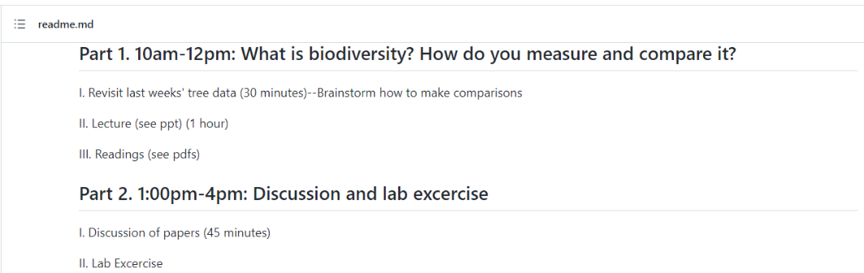

Slide 2
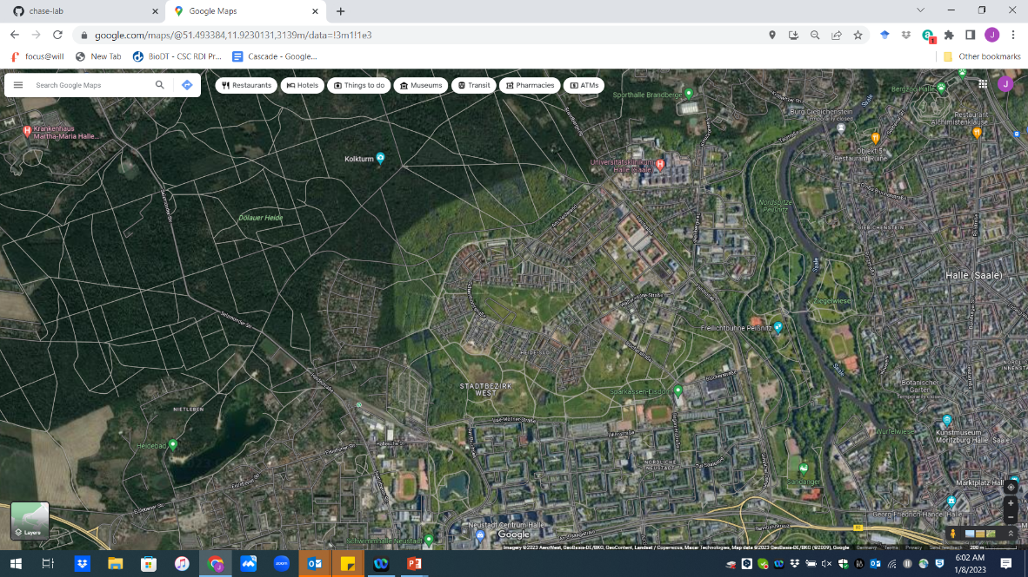

Slide 3
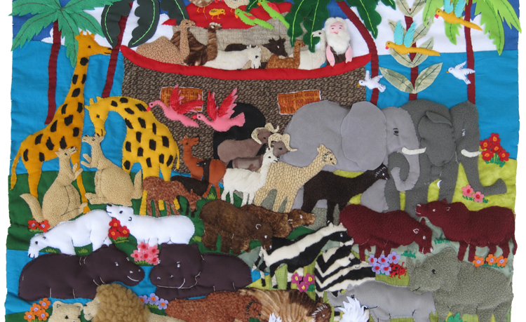
Quantifying and Comparing Biodiversity

Slide 4
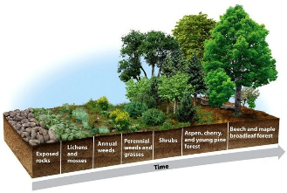
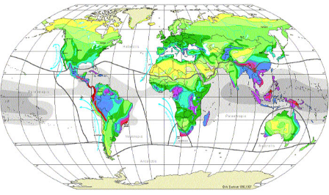
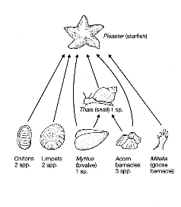
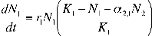
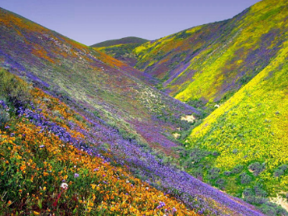
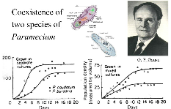
Process→Pattern
Pattern→Process

Slide 5
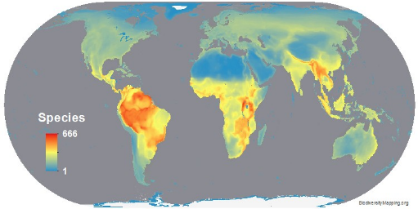
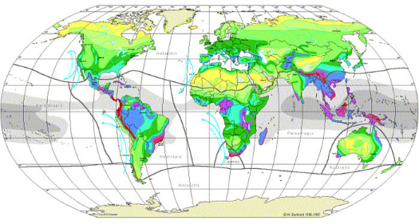
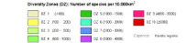
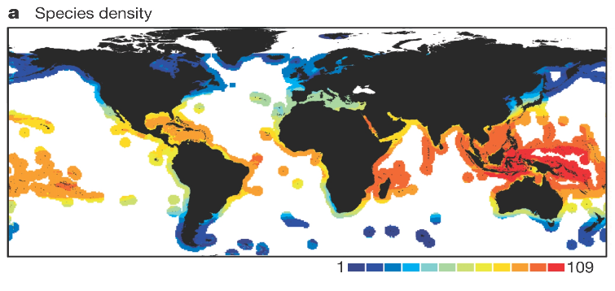
Bird Diversity
Vascular Plants
Marine Fishes

Slide 6
Major Ecological Gradients
Latitude
Elevation
Energy/Productivity
Heterogeneity
Disturbance
Island size/Habitat Loss
Biogeography, other factors

Slide 7
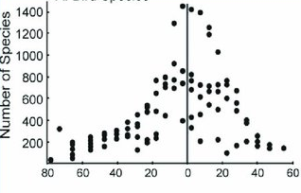
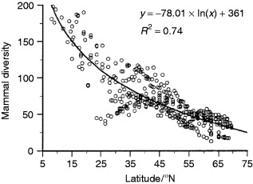
Latitude

Slide 8
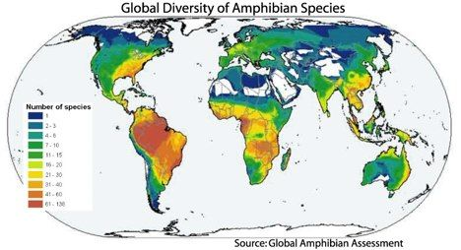
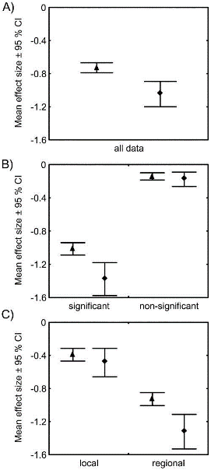
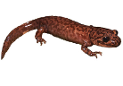
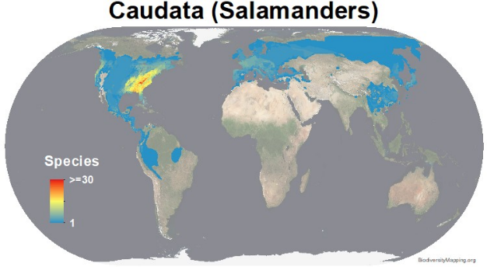
Taxonomic scale matters
Hillebrand 2004, American Naturalist

Slide 9
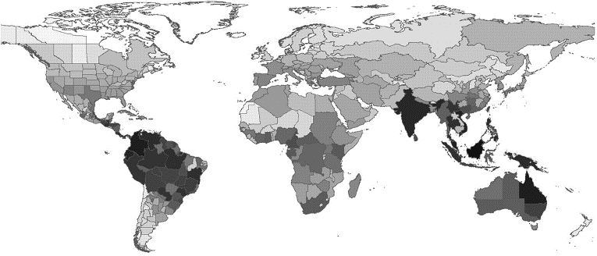
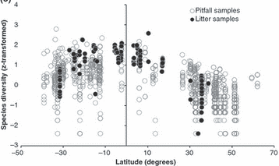
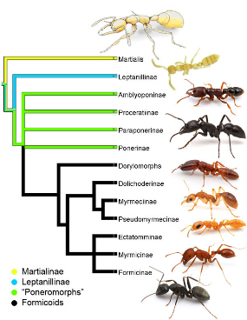
Biogeography matters
Dunn et al. 2009, Ecology Letters

Slide 10
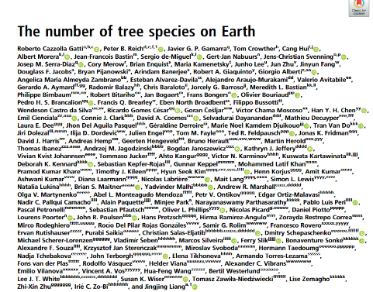

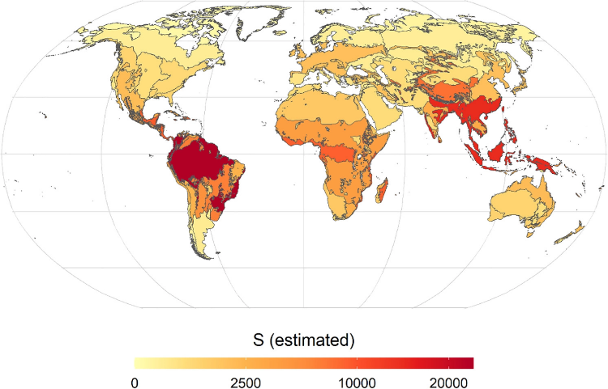
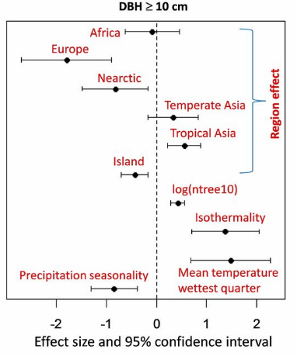

Slide 11
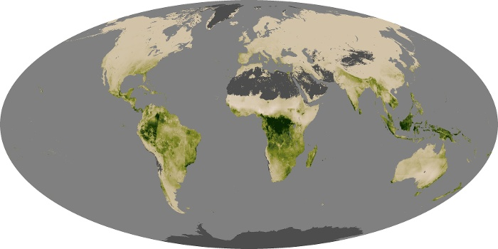
Why Latitude?
Area
Historical Biogeography
Climate
Global Net Productivity—NASA Observatory

Slide 12
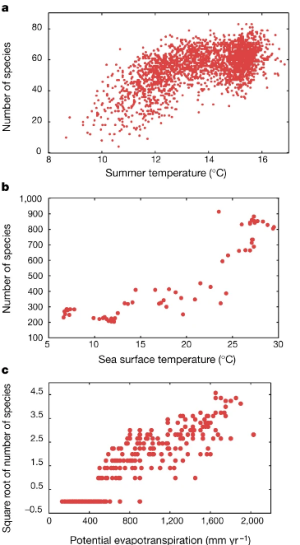
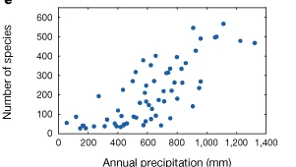
Precipitation, Energy, Temperature gradients

Slide 13
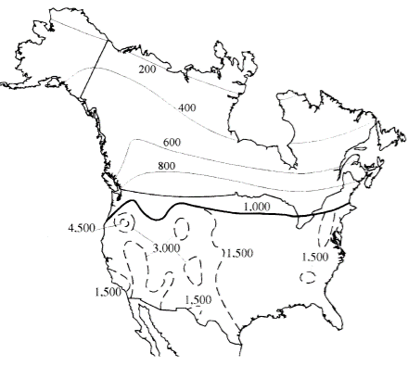
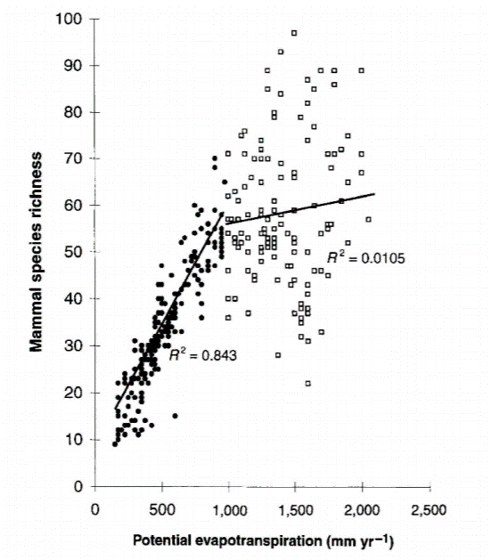
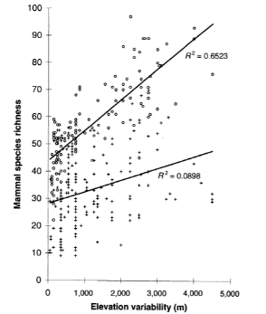
Habitat heterogeneity matters
Kerr and Packer 1997, Nature

Slide 14

Measuring Species Richness

Slide 15
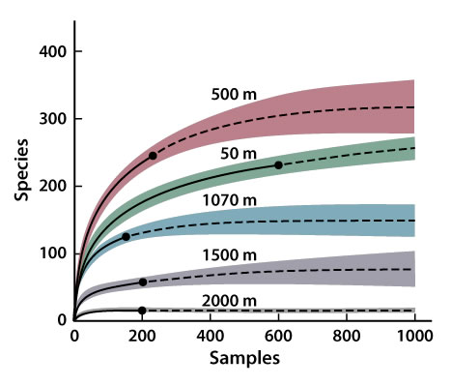
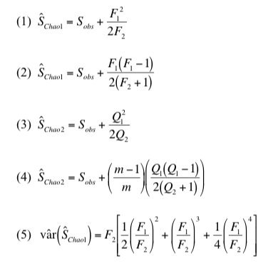
Species Richness Estimators: what is the ‘True’ species richness?
Work from Anne Chao and others

Slide 16
Assumption that there is an asymptote in species richness is invalid
Sampling extent
Number of species
Many solutions, all make improbable assumptions at some scale
Area, samples, or individuals

Slide 17
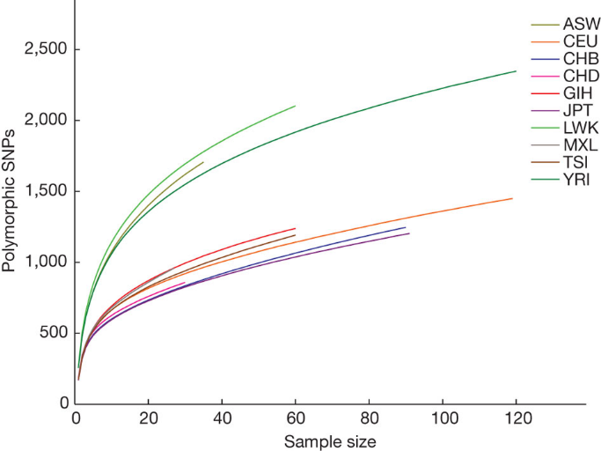
Same problems in genomics/genetics….

Slide 18
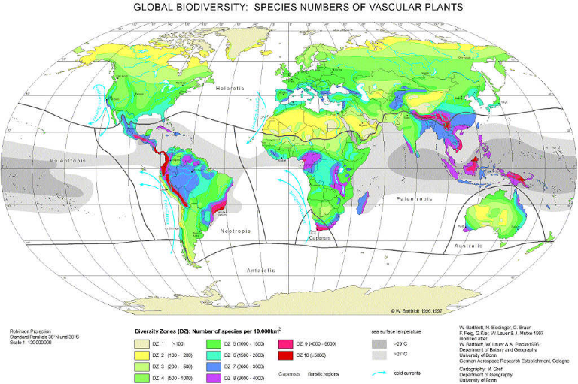
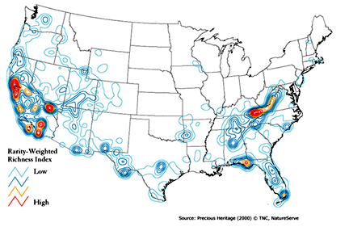
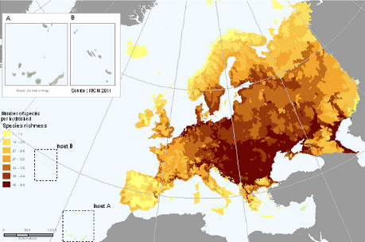
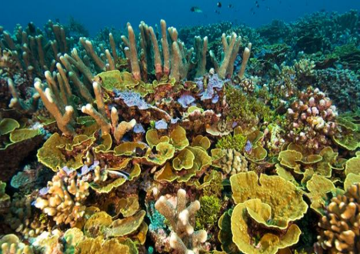

Slide 19
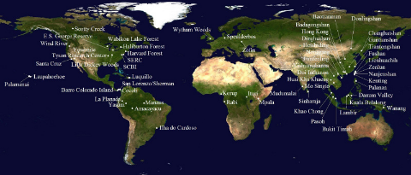
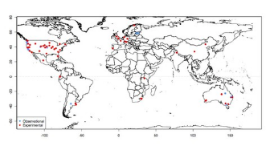
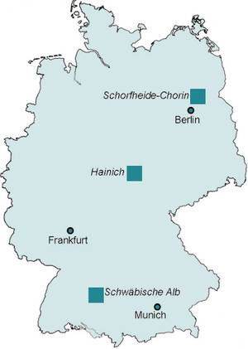
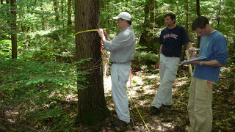
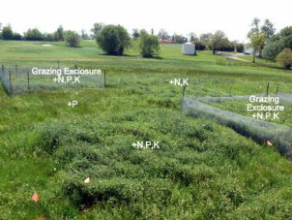

Aren’t consistent sampling schemes enough?
Unfortunately, no….
CTFS-SGIEO Forest Plots
NutNet Forest Plots

Slide 20
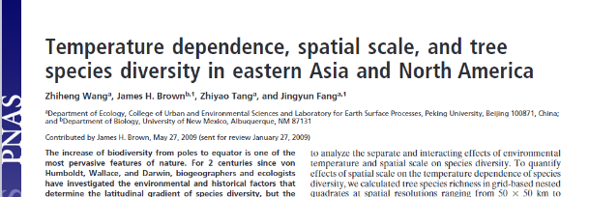

Slide 21
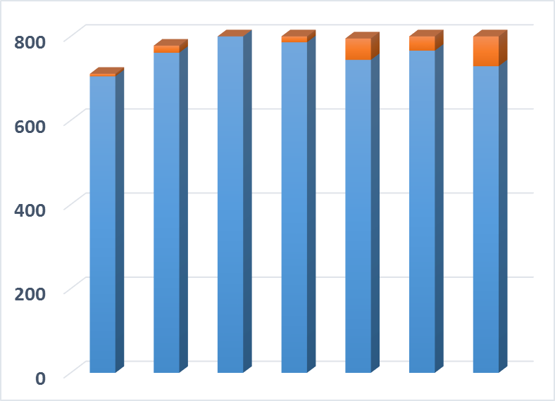
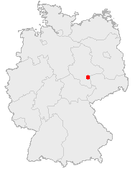
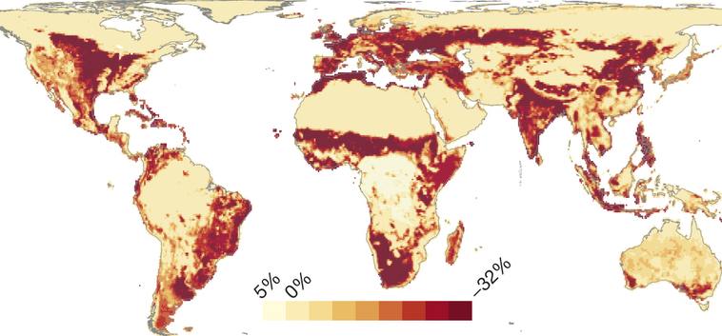
Scale-Dependent Biodiversity Change
Number of Species
Public Domain, https://commons.wikimedia.org/w/index.php?curid=362363
~1700
1850
1950
~Today
Year
Data from: Knapp, S., et al. 2016. Increasing species richness but decreasing phylogenetic richness and divergence over a 320‐year period of urbanization. Journal of Applied Ecology. doi:10.1111/1365-2664.12826
Reprinted by permission from Macmillan Publishers Ltd: Newbold, T., et al. 2015. Global effects of land use on local terrestrial biodiversity. Nature, 520: 45-50.

Slide 22
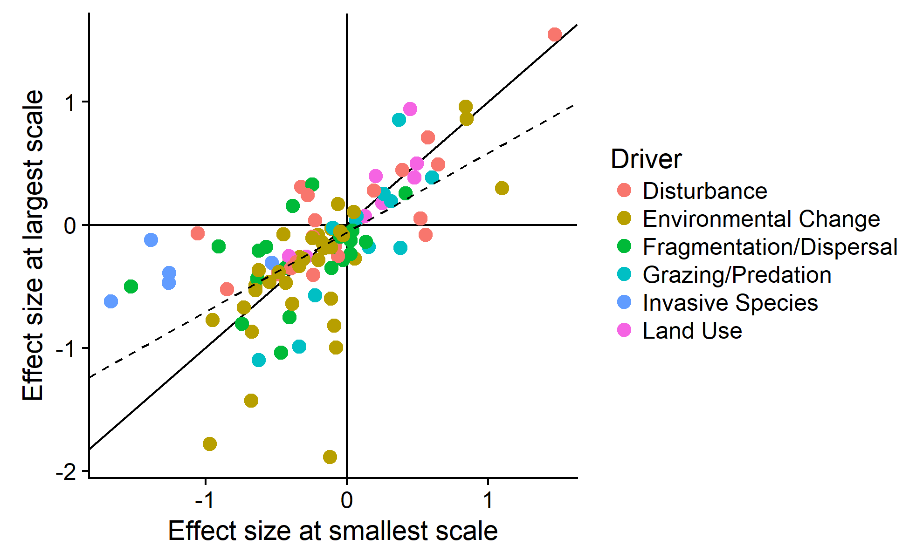
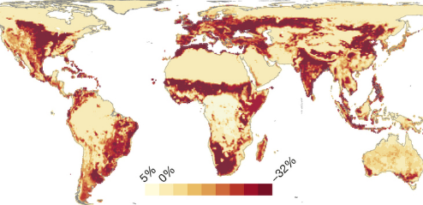
Scale-Dependence is the Rule
Small-scale Observations Often Overestimate Effects at Larger Scales
Opposite of homogenization
→Differentiation
Chase et al. 2018, Ecol. Lett.

Slide 23
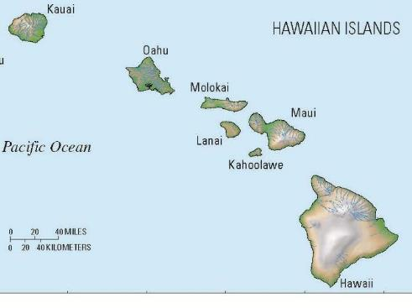




Homogenization or Differentiation

Slide 24

Biodiversity change—Scale matters
Theoretical Expectations
Meta-analytical results (plants only)

Slide 25


Scale-dependence is inevitable….
Species Richness
Sampling Effort
Species-Area Curve (many types)
Species Accumulation Curve
Rarefaction Curve

Slide 26





Biodiversity Scaling—

Slide 27
Different Kinds of Species Area Relationships (SARs)
Island Species Area Relationship (ISAR)
Scheiner 2003

Slide 28
Near Mainland
Far from Mainland
MacArthur and Wilson 1963

Slide 29
Different Kinds of Species Area Relationships (SARs)
Nested
Island Species Area Relationship (ISAR)
Scheiner 2003

Slide 30

Preston 1960

Slide 31


The classical Species Area Relationship (SAR) equation
$$S=cA^{z}$$
$$logS=logc{+ z logA}^{}$$
z (slope)
c (intercept)

Slide 32
Mechanisms of the SAR
Sampling
Heterogeneity
Area ‘Per se’ (=metacommunity processes)
Connor and McCoy 1979

Slide 33
SAR principles can be used to predict extinctions

Slide 34

From MacArthur and Wilson 1967

Slide 35
Island biogeography and extinctions
Koh and Ghazoul 2010

Slide 36

Any measure of diversity only captures part of the picture
α, richness, evenness, diversity entropy
β, similarity, distance decay
γ, SAR, EAR, etc

Slide 37
Sampling and Scale
(more/fewer individuals)
Degraded Community
Pristine Community
Small Effect
Large effect
10
Species Richness
8
6
4
2
0
0 30 60 90 120 150 180
Area Sampled
Chase and Knight 2013 Ecology Letters

Slide 38






Scale-dependence of invasive species impacts
2.0
R²=0.995, P<0.001
R²=0.978, P=0.001
1.5
Log(Species Richness)
1.0
Uninvaded
Invaded
0.5
0
1
2
3
Log(Area)

Slide 39

Horvath et al. 2019

Slide 40

Horvath et al. 2019

Slide 41
Graham and Blake 2001

Slide 42
Scale and Diversity: An example….
Germany vs. USA
….in BEER!!
Leipzig has good beer….but its diversity is low
-iDiv visitor from the U.S.

Slide 43









German beer is lower in diversity than the U.S…..Really?

Slide 44

Need a fair comparison---rarefaction

Slide 45


Leipzig has good beer….but diversity is low
Grain—
what is the scale in which data are aggregated?
Extent—
What is the scale of comparison?

Slide 46
Biodiversity is fundamentally scale (grain, extent) dependent
Grain
Extent

Slide 47

3.5
3.0
2.5
2.0
1.5
1.0
0.5
0
Log Number of beer types
Pub
City
State
Country (rarefied)
Country
Scale of observation (grain/extent)

Slide 48




Can’t we just correct for area?
Number of species per area
Large island
Medium island
Number of Species
Small island
Area sampled

Slide 49




Slide 50



Garbage in….
…Garbage out

Slide 51
Solutions are not as easy as they might seem…
Extrapolations and interpolations are still strongly biased by sample grain/extent
Partitioning of scales (e.g., α-diversity, β-diversity, γ-diversity) doesn’t account for non-linearities
Explicit scaling exponents (e.g., species-accumulations, species-area relationships) are confounded by multiple factors

Slide 52


.. we already have a way to deal with scale…β-diversity
α β = γ
β = γ/α
γ-diversity (21)
10
3
α-diversity
4
11
= 21 / 7
= 3
5
9
α-diversity
β-diversity is a scalar from local (α) to regional (γ)

Slide 53
β-diversity is also complicated
γ-diversity
β-diversity
Diversity
α-diversity
Local Regional
Spatial Scale
Linearization of an inherently non-linear pattern
Shape determined by several distinct components that underlie SAC
Critically grain and extent dependent

Slide 54
Sample Grain and Extent drive β-diversity
Larger grain/extent
α-diversity
α-diversity
γ-diversity
γ-diversity
β
β
Number of Species
β
β
Area sampled

Slide 55
Sample problems in genomics/genetics….

Slide 56


Other kinds of diversity—Ethnic, Language, etc

Slide 57



Economics has been doing something similar for some time (Gini Coefficient)

Slide 58
Just what is (or is not) changing??
Abundance or biomass
Species richness
Dominance or evenness
Species composition (favorable vs unfavorable)
Do the metrics correlate??

Slide 59





Insect Decline
2542 citations in Google Scholar

Slide 60



Slide 61


Biodiversity across scales
Number of individuals
Species relative abundances
Spatial distribution
(e.g. aggregation)
Biodiversity drivers (Land use, climate, invaders, …)
package mobsim

Slide 62



package mobsim
https://github.com/MoBiodiv/mobsim

Slide 63




